Slide 1
ATAI
Advanced Techniqueof Artificial Intelligence
ATAI
ChongqingUniversity _{AdvancedTechniqueof}
of Technology Artificial Intelligence
Chongqing University of
Technology
Chongqing University ^{ATAI}
_{of Technology} Advanced Techniqueof
Artificial Intelligence
Chongqing University of Technology
Chongqing University of Technology
Plug-in Diffusion Model for Sequential Recommendation
CODE:NO
——AAAI2024
Reported by ZhenDong Huanzg
1

Slide 2
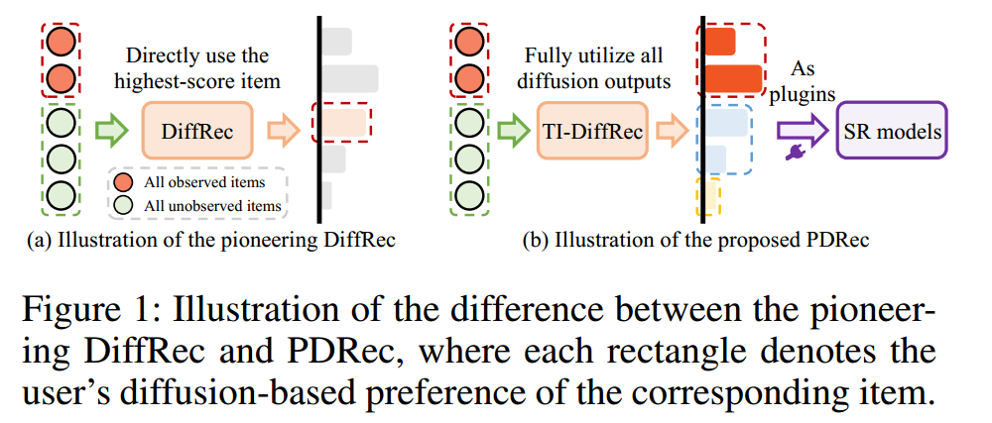
ATAI
AdvancedTechniqueof
Artificial Intelligence
ATAI
ChongqingUniversity _{AdvancedTechniqueof}
of Technology Artificial Intelligence
ChongqingUniversity of Technology
Motivation
(1)these methods merely utilize the highest-scored item as the final prediction in recommendation, overlooking users’ preferences towards other items in corpus and struggling with data sparsity issue.
(2)These DM-based methods are primarily proposed for collaborative filtering failing to fully integrate the time-aware sequential behavioral information.

Slide 3
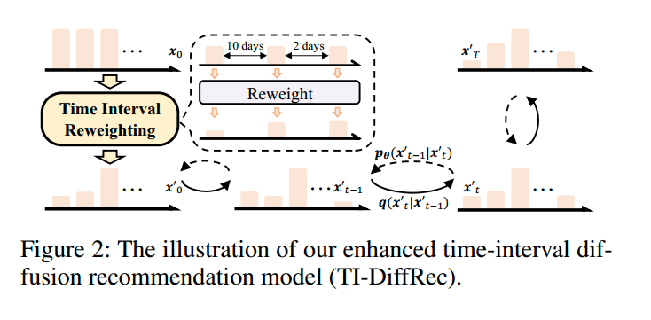
ChongqingUniversity of Technology
ATAI
AdvancedTechniqueof
Artificial Intelligence
ATAI
ChongqingUniversity _{AdvancedTechniqueof}
of Technology Artificial Intelligence
Overview

Slide 4
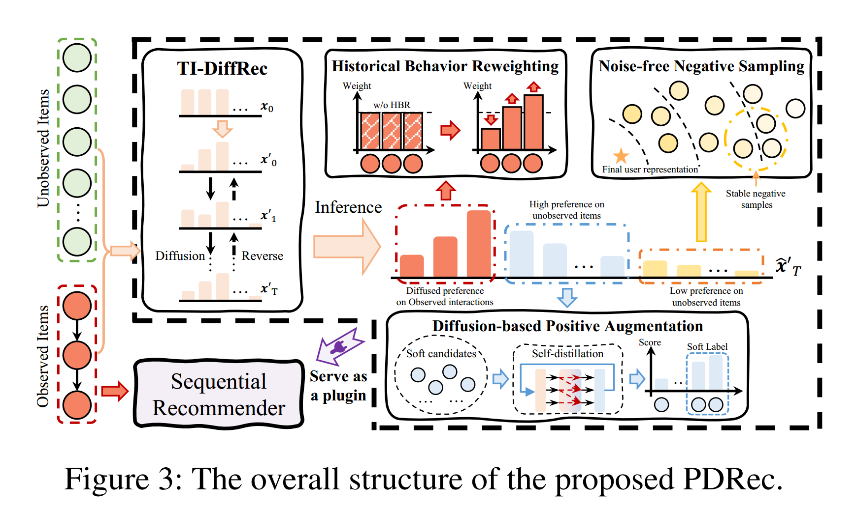
ChongqingUniversity of Technology
ATAI
AdvancedTechniqueof
Artificial Intelligence
ATAI
ChongqingUniversity _{AdvancedTechniqueof}
of Technology Artificial Intelligence
Overview

Slide 5
ChongqingUniversity of Technology
ATAI
AdvancedTechniqueof
Artificial Intelligence
ATAI
ChongqingUniversity _{AdvancedTechniqueof}
of Technology Artificial Intelligence
Method

Slide 6
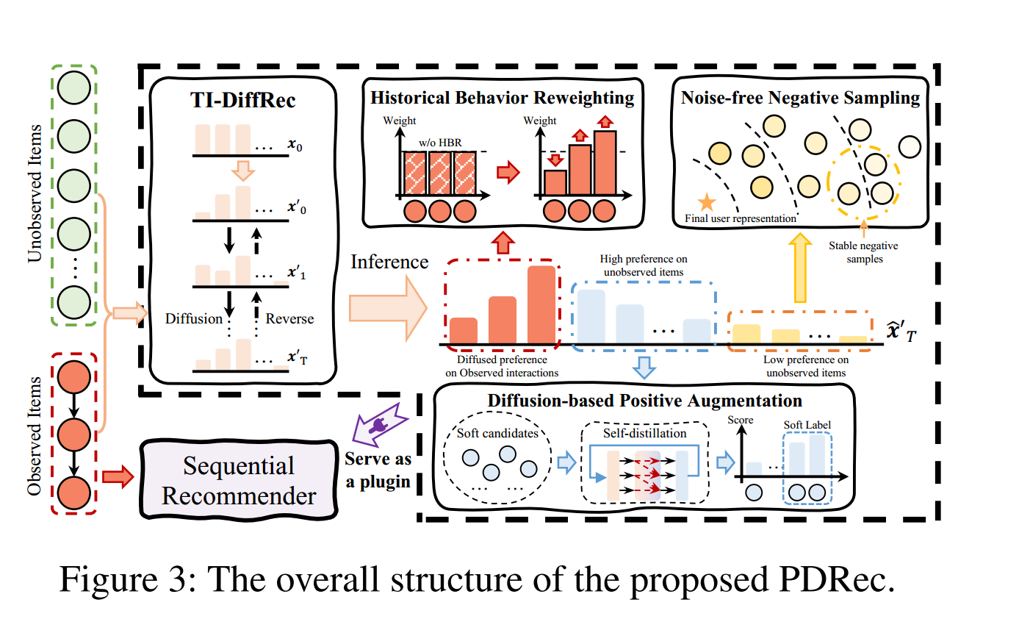
ChongqingUniversity of Technology
ATAI
AdvancedTechniqueof
Artificial Intelligence
ATAI
ChongqingUniversity _{AdvancedTechniqueof}
of Technology Artificial Intelligence
Method

Slide 7
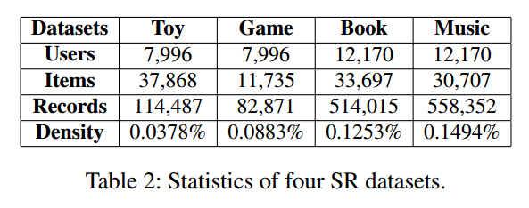
ATAI
AdvancedTechniqueof
Artificial Intelligence
ATAI
ChongqingUniversity _{AdvancedTechniqueof}
of Technology Artificial Intelligence
ChongqingUniversity of Technology
Experiments

Slide 8
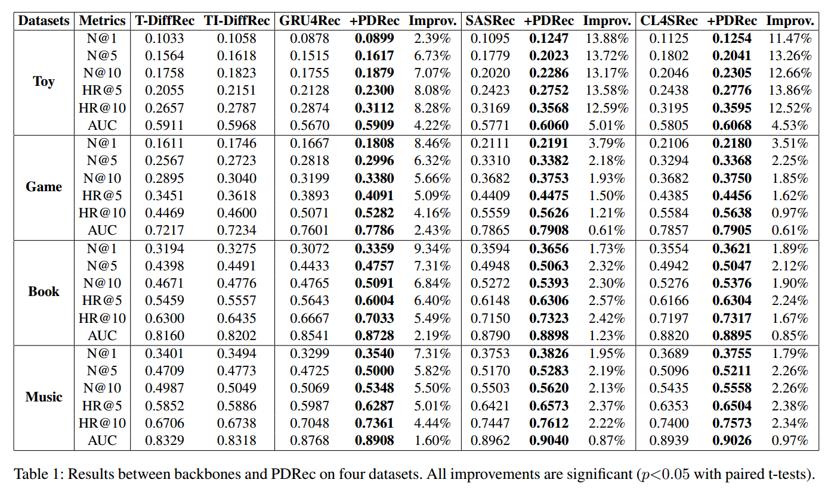
ATAI
AdvancedTechniqueof
Artificial Intelligence
ATAI
ChongqingUniversity _{AdvancedTechniqueof}
of Technology Artificial Intelligence
ChongqingUniversity of Technology
Experiments

Slide 9
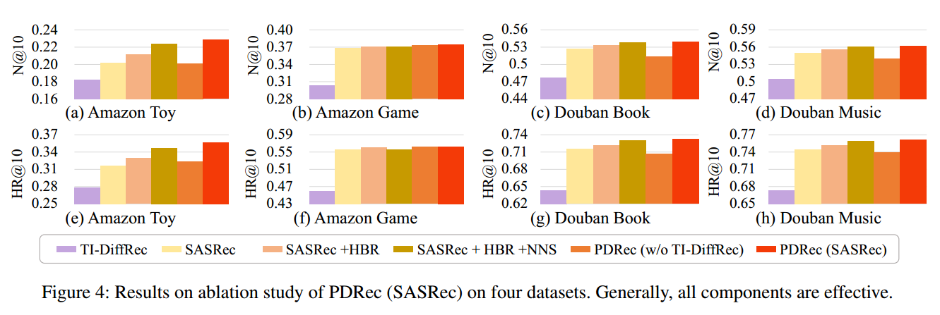
ChongqingUniversity of Technology
ATAI
AdvancedTechniqueof
Artificial Intelligence
ATAI
ChongqingUniversity _{AdvancedTechniqueof}
of Technology Artificial Intelligence
Experiments

Slide 10
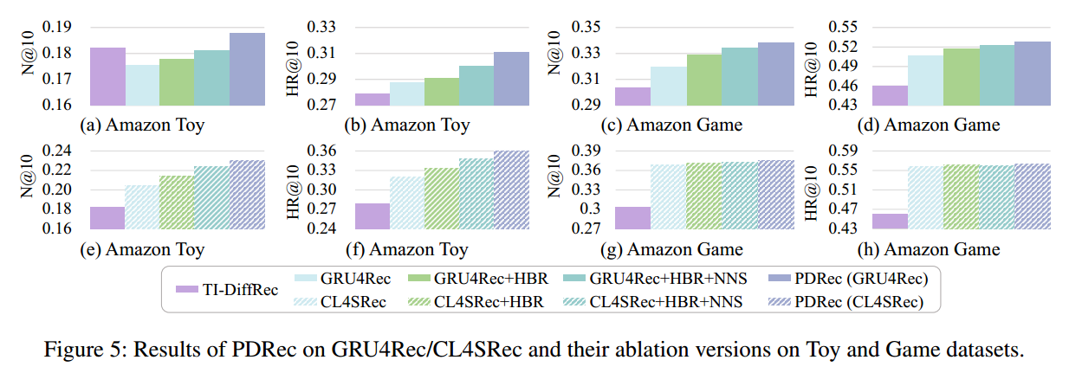
ChongqingUniversity of Technology
ATAI
AdvancedTechniqueof
Artificial Intelligence
ATAI
ChongqingUniversity _{AdvancedTechniqueof}
of Technology Artificial Intelligence
Experiments

Slide 11
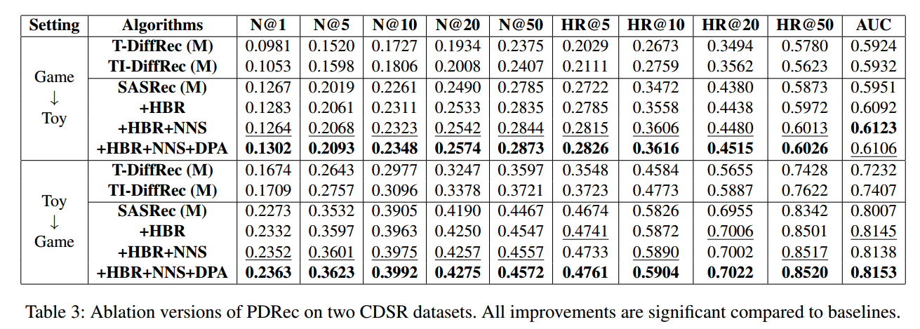
ChongqingUniversity of Technology
ATAI
AdvancedTechniqueof
Artificial Intelligence
ATAI
ChongqingUniversity _{AdvancedTechniqueof}
of Technology Artificial Intelligence
Experiments

Slide 12
ChongqingUniversity of Technology
ATAI
AdvancedTechniqueof
Artificial Intelligence
ATAI
ChongqingUniversity _{AdvancedTechniqueof}
of Technology Artificial Intelligence
Thanks!

